Slide 1
Setting up a web server
MAMP/WAMP

Slide 2
MAMP and WAMP
WAMP: Windows Apache MYSQL and php
MAMP: Mac Apache MYSQL and php

Slide 3
Components
Apache is a web server
Mysql is a relational database management system
PHP is a server side scripting language

Slide 4
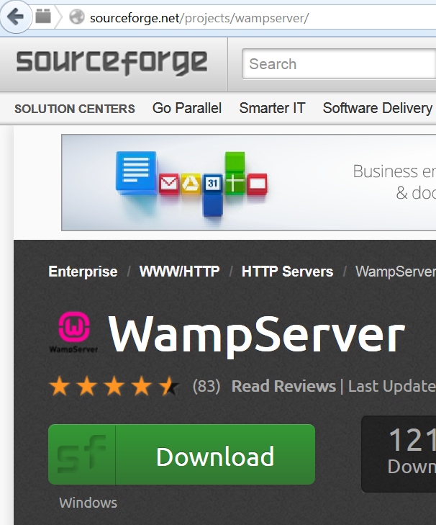
WAMP is downloaded from Sourceforge

Slide 5
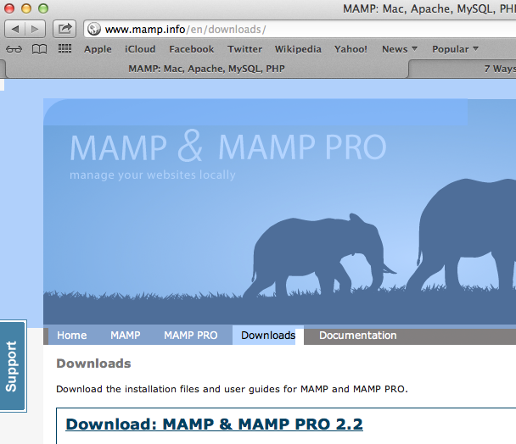
MAMP is downloaded from mamp.info

Slide 6
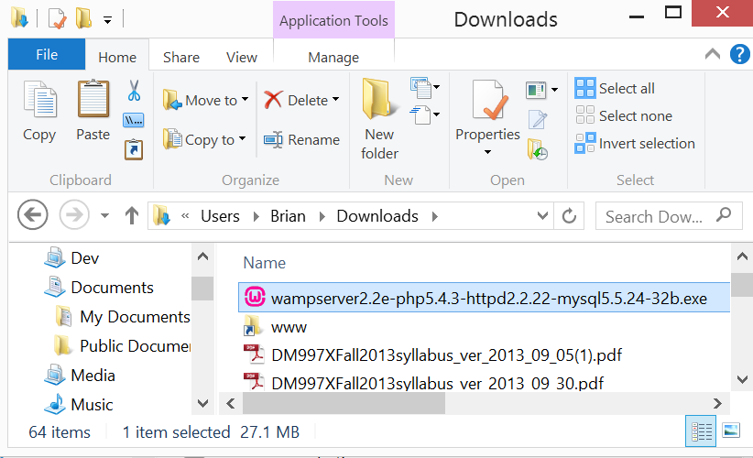
Windows Setup
Double-click the self-extracting archive file wampserver….exe.

Slide 7
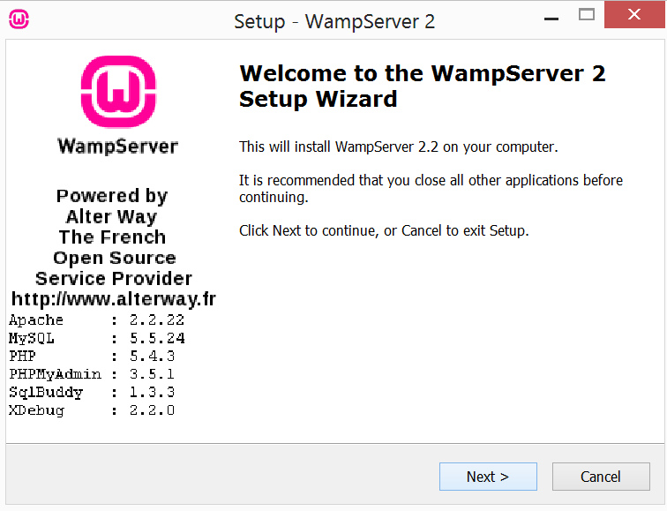
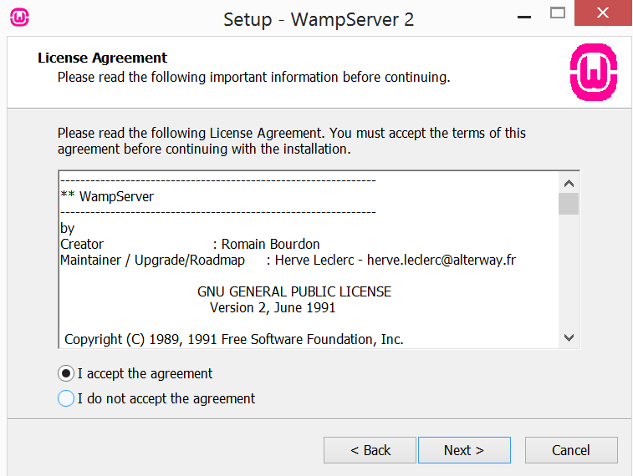
Windows Setup

Slide 8
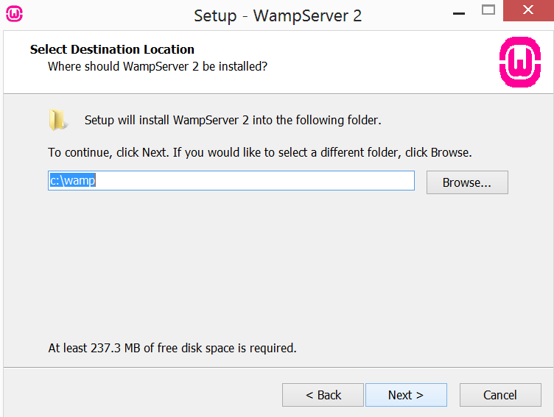
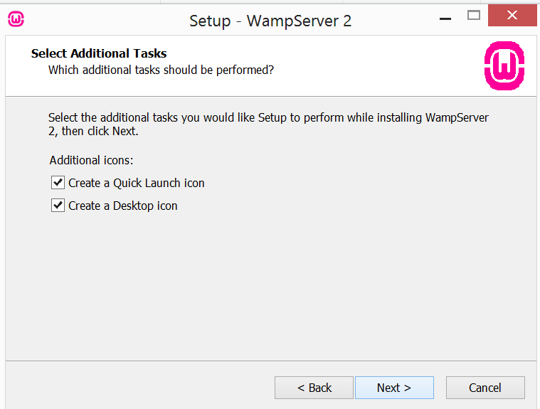
Windows Setup

Slide 9
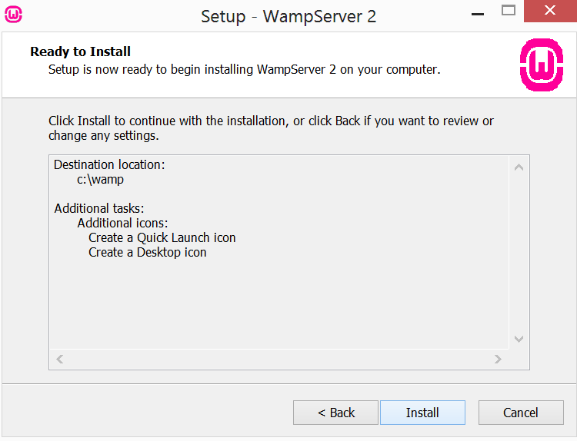
Windows Setup

Slide 10
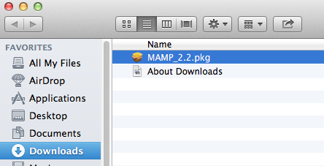
Mac Setup
Double-click the Mamp.pkg file.

Slide 11
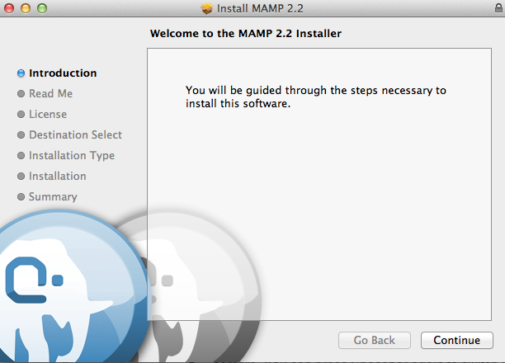
Mac Setup

Slide 12
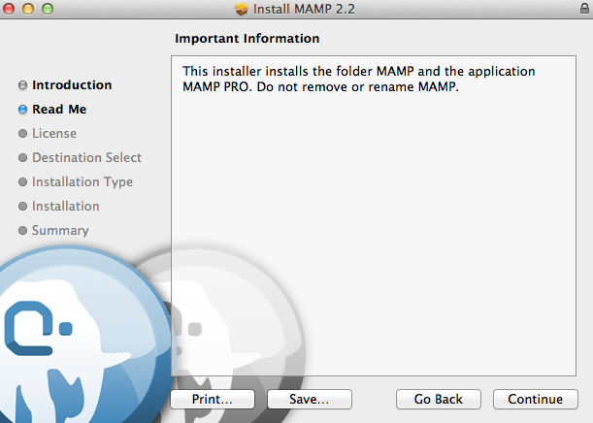
Mac Setup

Slide 13
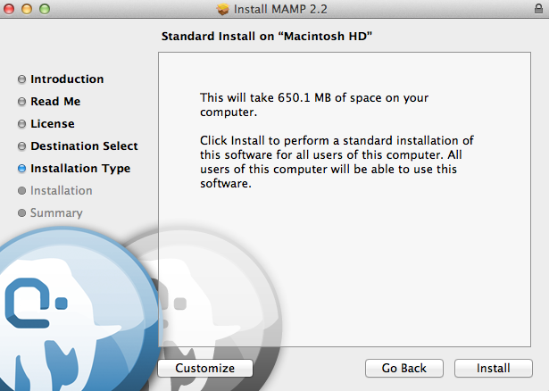
Mac Setup

Slide 14
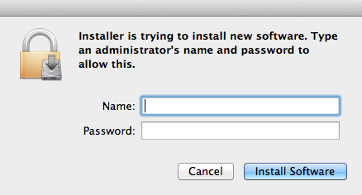
Mac Setup

Slide 15
Mac Setup
By default MAMP will be setup in the Applications folder.

Slide 16
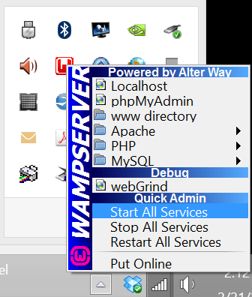
Start Server Windows
Start the server from the taskbar by clicking on the W icon and select Start all services

Slide 17
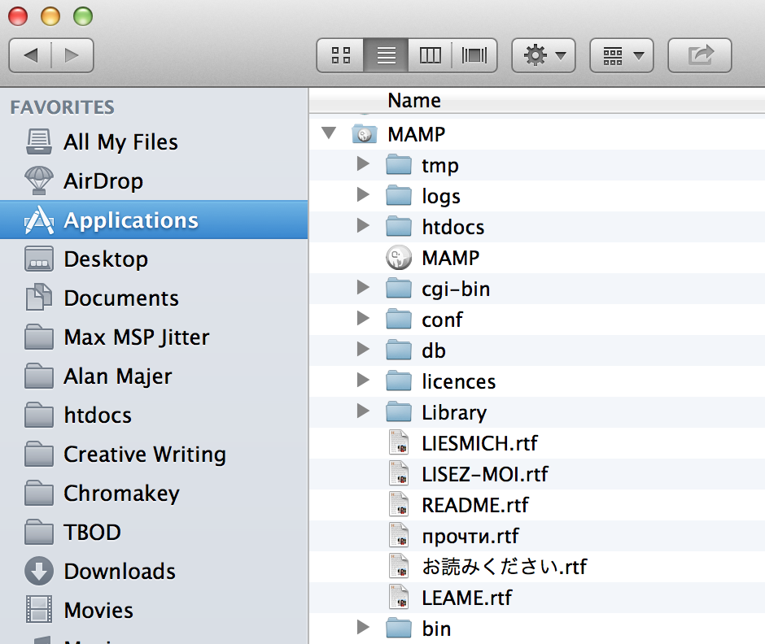
Start Server Mac: Applications MAMP

Slide 18
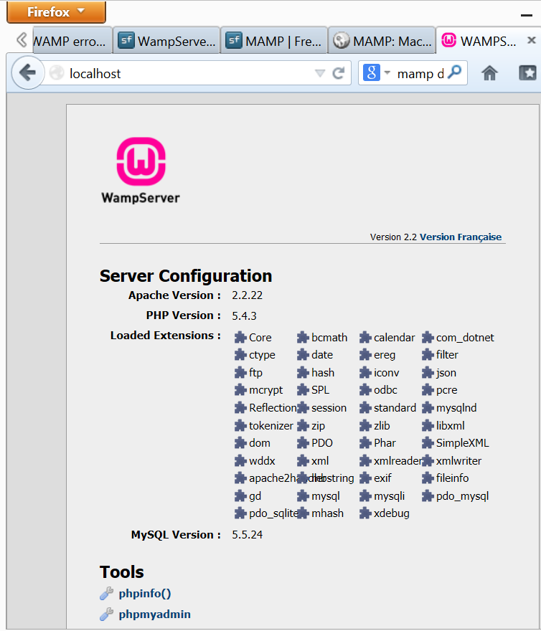
Launch!
Launch the server control panel by typing localhost in your browser location bar.
Note that if you had to change the default port you must include that also (for example localhost:8080)

Slide 19
Installation Issues
There are two common installation issues:
1 Restrictive permissions
The application will not work if the server does not proper permissions
2. Port Conflicts
Some applications, for example Skype, will conflict with default port settings
Permissioning and port conflicts can both be resolved through configuration files.

Slide 20
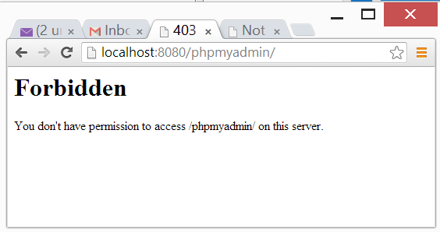
Restrictive Permissions
By default permissions are restrictive. If you cannot access the dashboard page by typing localhost (or localhost:nn If you are using a non-default port) you may need to alter your server configuration file.

Slide 21
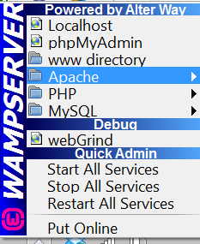
The WAMPSERVER Control Panel
The WAMPserver control panel is launched by the green W icon on the taskbar.
Use it to start and stop the server, and to edit configuration files

Slide 22
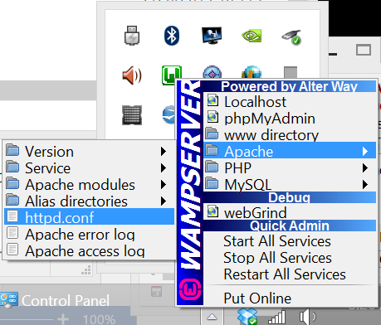
Editing the httpd.conf File
Select Apache / httpd.conf from the WAMPSERVER control panel to edit the httpd.conf file.

Slide 23
Editing the Apache httpd.conf File
<Directory "c:/wamp/apps/phpmyadmin3.4.5/">
Options Indexes FollowSymLinks MultiViews
AllowOverride all
Order Deny,Allow
Allow from all
</Directory>

Slide 24
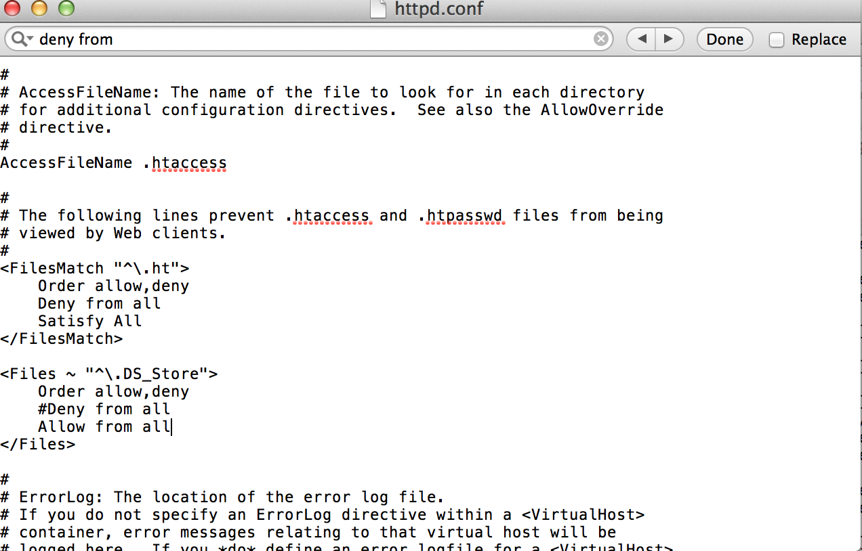
Configuring http.conf MAMP

Slide 25
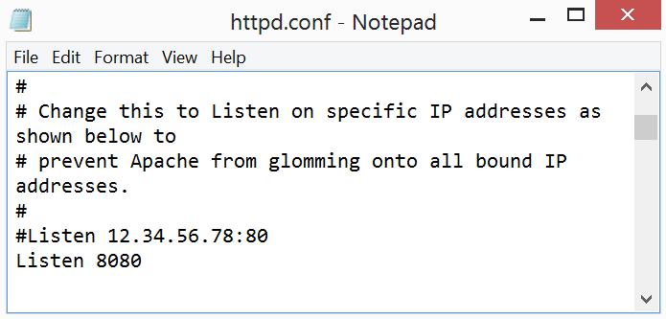
Changing Ports in httpd.conf
By default the Apache webserver listens for requests on port 80. This frequently causes conflicts with other software, for example Skype.

Slide 26
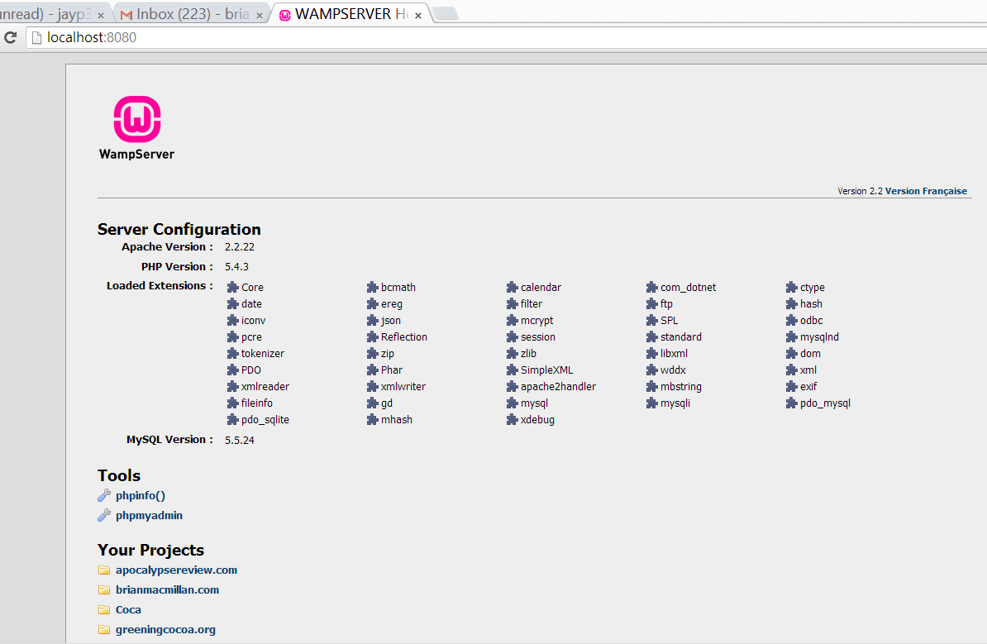
Configuring the Server

Slide 27
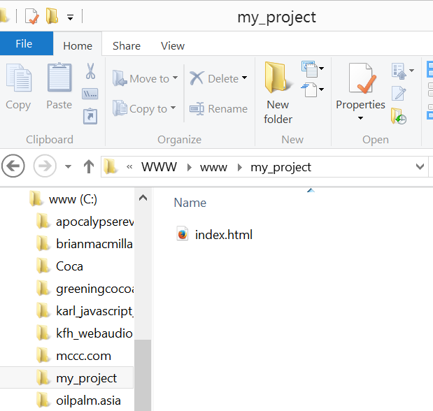
Launching a Webpage
Create a project folder in your web folder (httdocs on the Mac, the www folder in Windows.
Create an html file called index.html and place it in the project folder

